Slide 1
Software Quality Assurance

Slide 2
IEEE 730-2014
IEEE offers many standards for software development
Not everyone agrees that they are valuable
Another popular SQA guidance resource is the Capability Maturity Model Integration (CMMI)
Notes:
http://www.academia.edu/15062663/IEEE_Standard_for_Software_Quality_Assurance_Processes

Slide 3
Software Quality Assurance
A set of activities that define and assess the adequacy of software processes
To provide evidence that establishes confidence that the software processes are appropriate for and produce software products of suitable quality for their intended purposes
A key attribute of SQA is the objectivity of the SQA function with respect to the project. The SQA function may also be organizationally independent of the project; that is, free from technical, managerial, and financial pressures from the project.

Slide 4
Scope of IEEE 730-2014
Establishes requirements for
Initiating, planning, controlling and executing SQA processes for software development and maintenance

Slide 5
Purpose
Produce and collect evidence for a justified statement of confidence that the product conforms to requirements
This standard provides uniform, minimum acceptable requirements for SQA processes

Slide 6
Outcomes of SQA
SQA Process Implementation. A strategy for conducting SQA is developed. SQA activities are planned and executed. Evidence of SQA is produced and maintained.
Product Assurance. Adherence of products to the established requirement is evaluated. Problems and non-conformance are identified and recorded.
Process Assurance. Adherence of processes and activities to the applicable standards and procedures is verified. Effectiveness of processes is evaluated and improvements are suggested. Problems and non-conformance are identified and recorded.

Slide 7
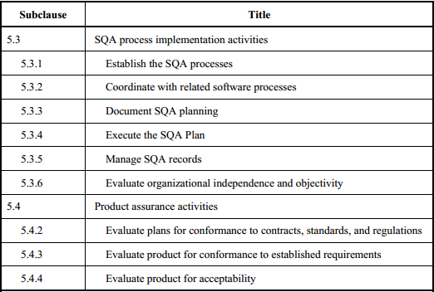
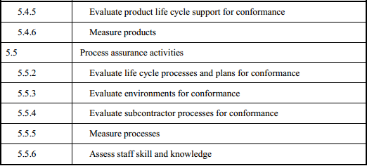
SQA Activities

Slide 8
SQA and Agile
How do you think SQA fits with Agile?
How does Agile deal with process and process improvement?

Slide 9
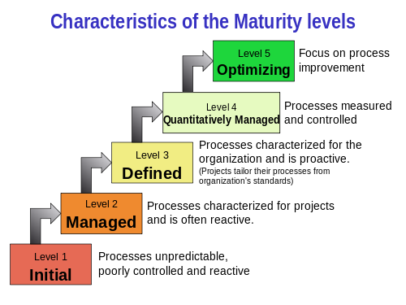
CMMI Overview

Slide 10
CMMI Level 1 - Chaos
You'd be surprised how many organizations operate at this level
There isn't a lot to say about this level

Slide 11
CMMI Level 2 - Managed
Processes are happening
They are not documented
People just know and improvise
This is a reactive level

Slide 12
CMMI Level 3 - Defined
Level 2 is satisfied
The processes are documented
Training might be available on the processes
This is a proactive level

Slide 13
CMMI Level 4 – Quantitative
Quantifiable measures are in place to provide object data about process effectiveness
Project Management uses the quantified data to make decisions

Slide 14
CMMI Level 5 - Optimizing
Organizational management uses quantified data for decisions
Data is also used to analyze and improve processes

Slide 15
Agile and CMMI
How do you think an Agile team would fit in the CMMI levels?

Slide 16
Example of SQA Practice –Coding Standards
Many companies have standards
Some companies actually use them
Standards can be enforced by
Formal code inspections
Pair programming

Slide 17
Why Coding Standards
Extremely rare that the person who wrote the code will be the only one to work with it
Need to make code consistent so everyone can read it and understand it
Reduce errors when other people modify your code
Allows others to focus on what you are saying in code rather than how you said it

Slide 18
Two Java Coding Standards
The short one referenced for this class
https://web.archive.org/web/20120130010334/http://www.cwu.edu/~gellenbe/javastyle/index.html
A long version from Google
https://google.github.io/styleguide/javaguide.html

Slide 19
Code Inspections
A code inspection involves reviewing someone else’s code
Report non-conformance with agreed upon standards
Question difficult to understand sections
Report defects

Slide 20
Pair Programming
Pair programming is when two developers create code together at one computer
It should be a real-time code inspection

